Slide 1
What do leaders do? CORES-AD 66
Pablo Hernandez-Lagos
February 2, 2016

Slide 2
What do leaders do?

Slide 3
Gilgamesh
text

Slide 4
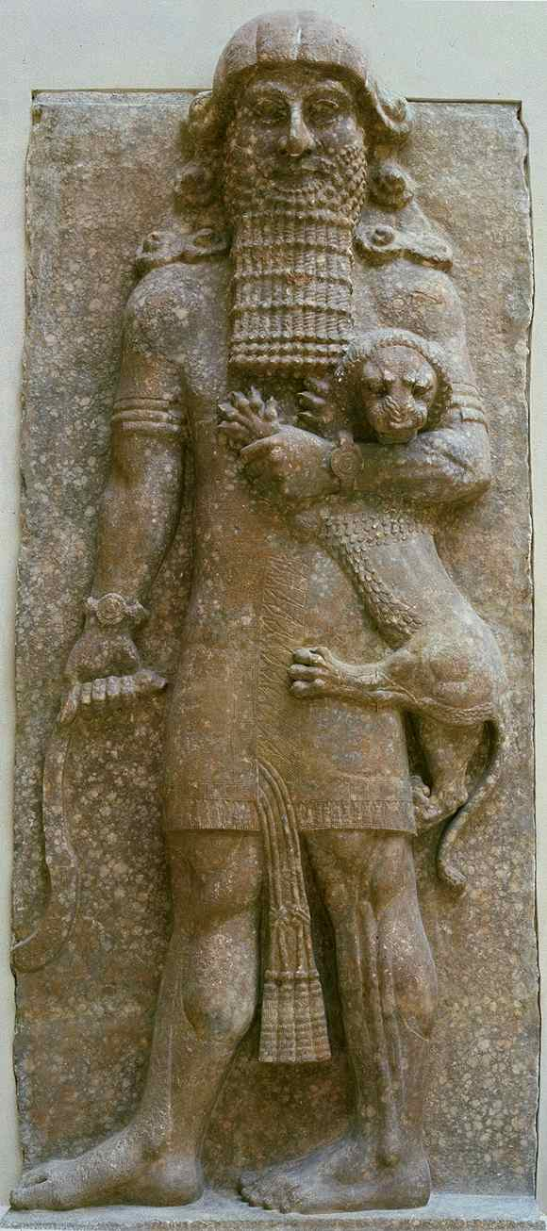

Slide 5
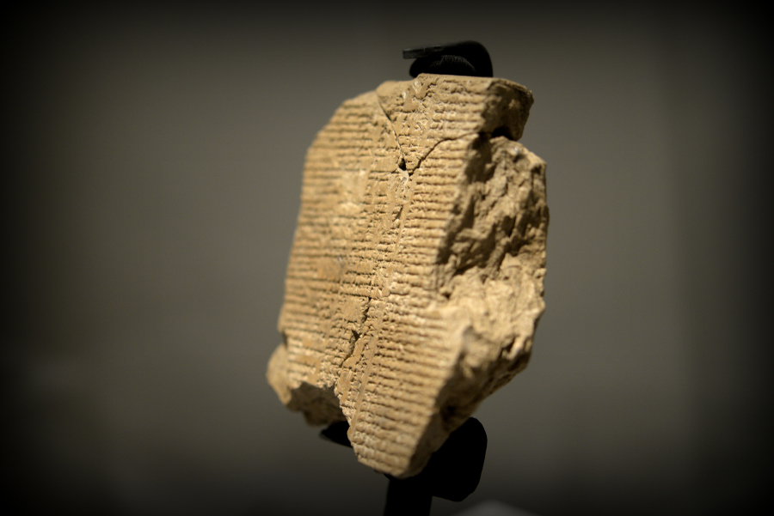

Slide 6
What do leaders want?
To be and remain influential
To solve other people’s problems
To have an easy life
To transcend life
To sacrifice themselves for others

Slide 7
Assertion: “Leaders want to be and remain influential”

Slide 8
Assertion: “Leaders want to be and remain influential”
Your first report will be based on this assertion. You may agree or disagree with it. In any case, you should follow the structure introduced in the first class.

Slide 9
Presentation of the report
Tuesday 2/9/2016
Al Gergawi, Amal Ismail Abdulla Ali
Al Neaimi, Haneen Ali
AlMemari, Maitha Salem
AlMheiri, Sarah Ali
Alblooshi, Mohammed Ahmed
Any format, only constraint: 5 minutes

